Slide 1
Trees in the R environment
RPM 2017
DIY analysis with open source software

Slide 2
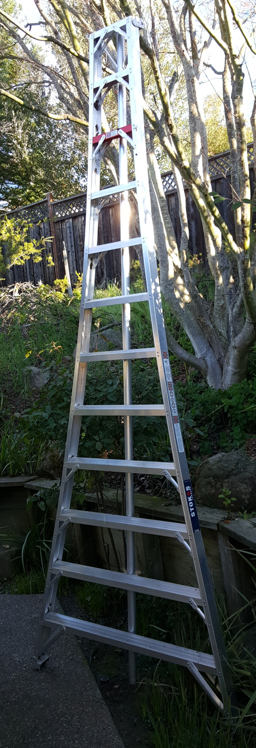


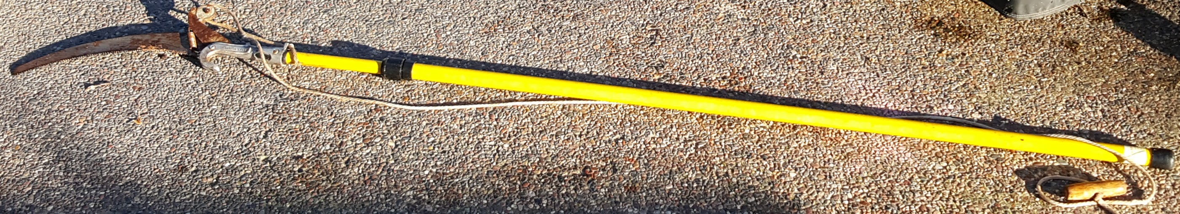
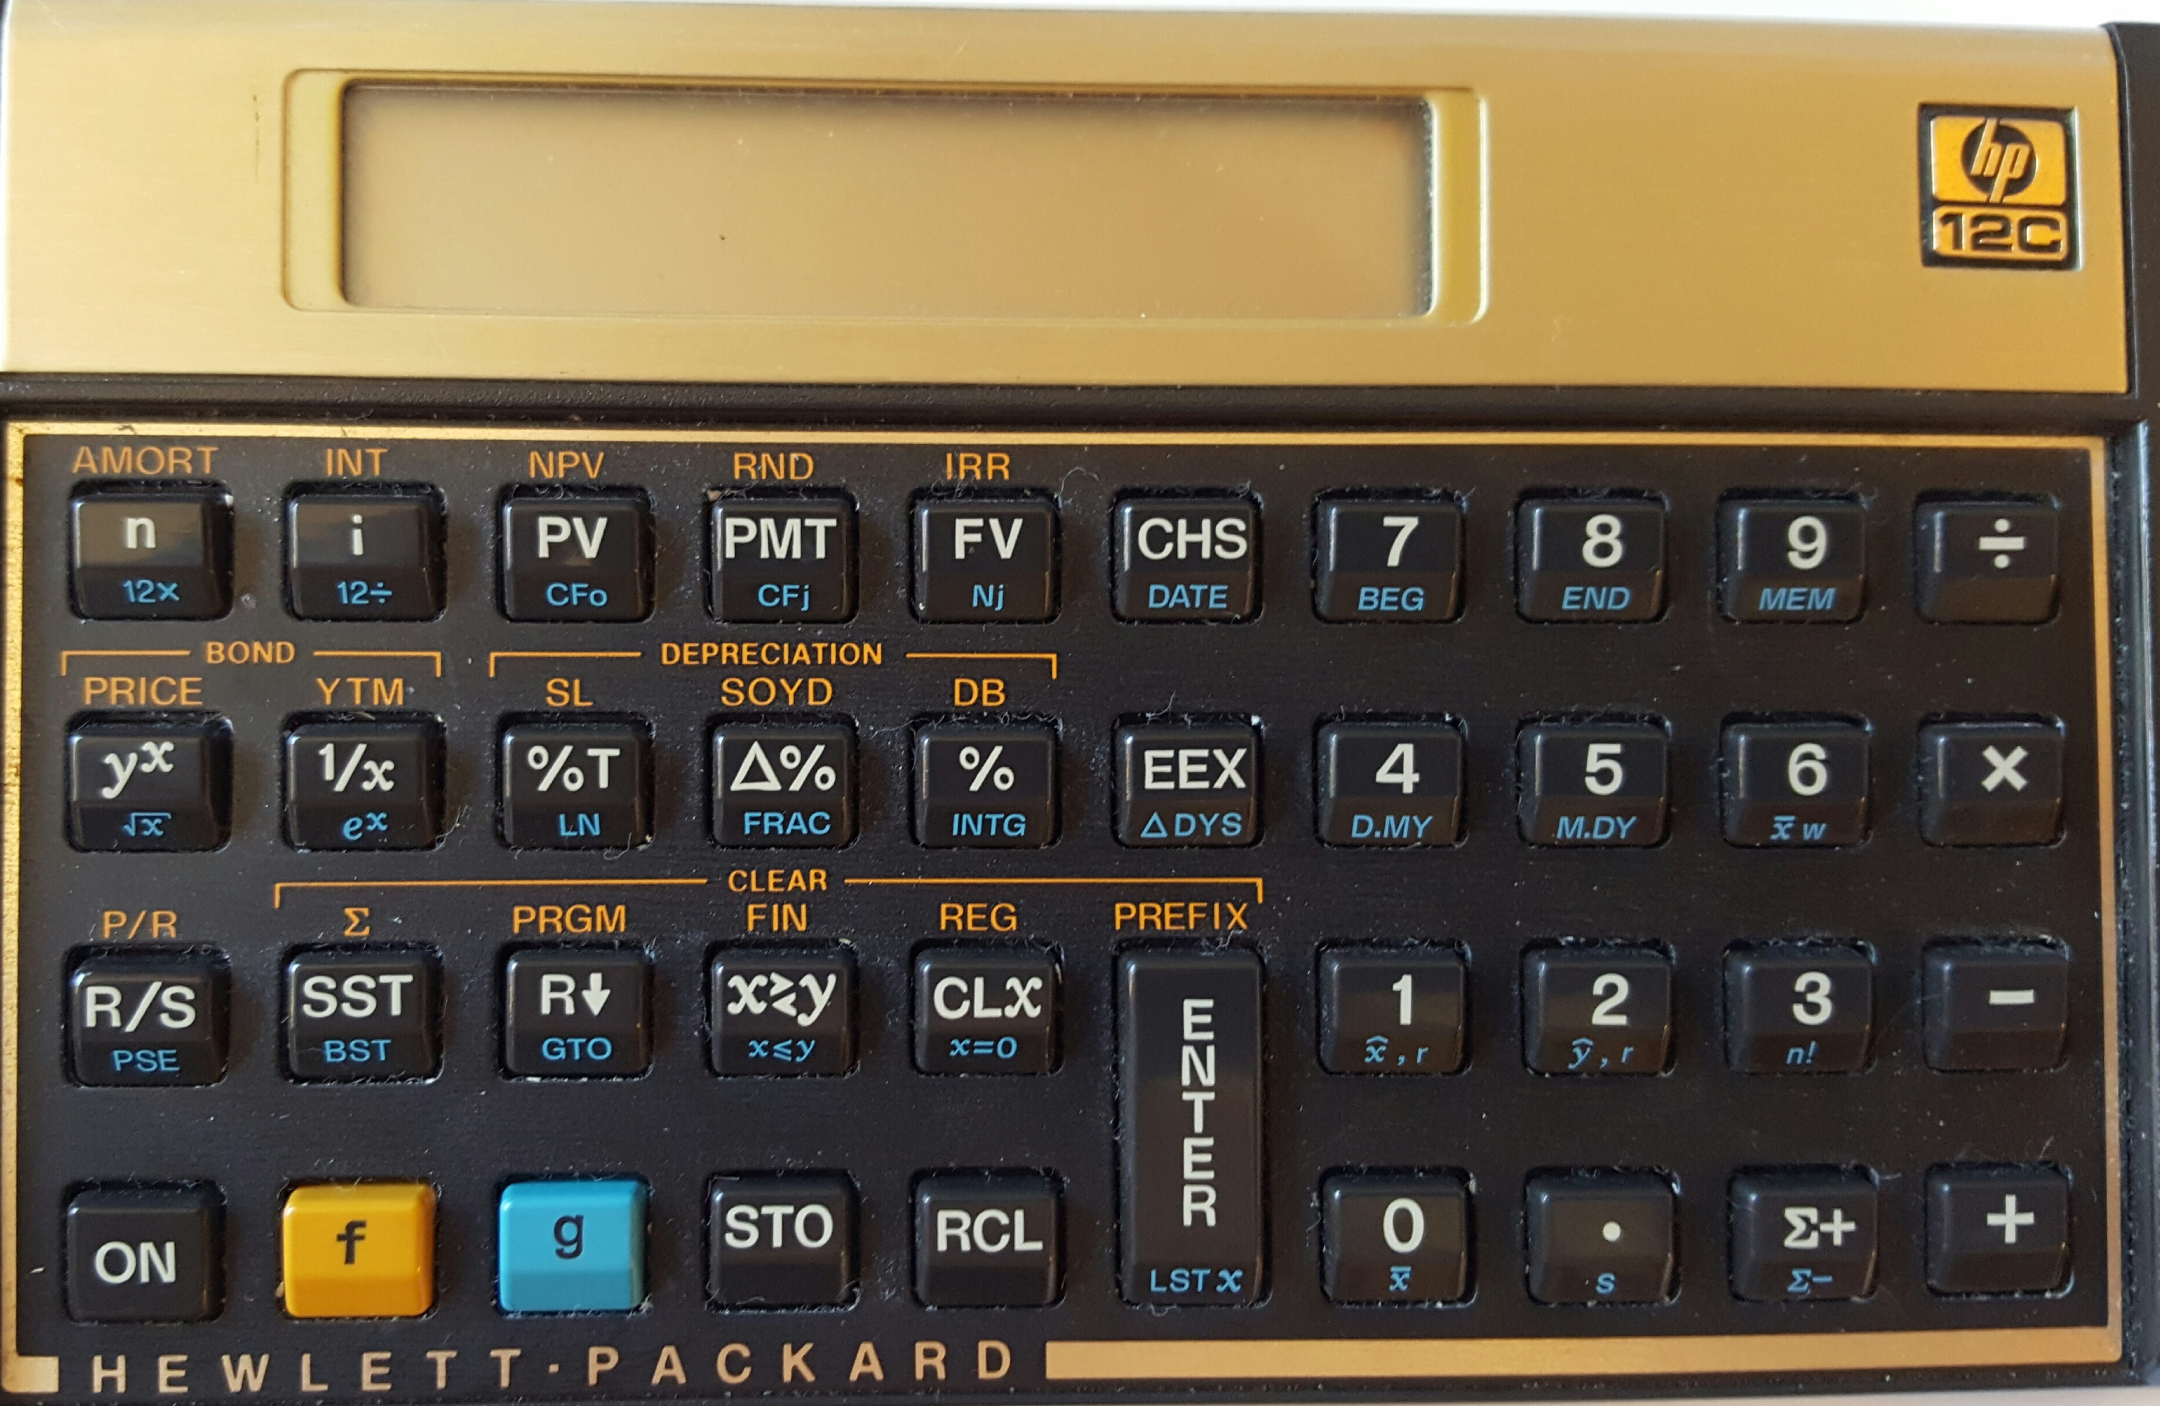

Modelers are builders. Builders use tools
Per Merriam-Webster a tool is
A handheld device that aids in accomplishing a task
An apparatus used in the practice of a vocation or profession
Notes:
http://www.merriam-webster.com/dictionary/tool for first two
http://www.urbandictionary.com/define.php?term=tool

Slide 3




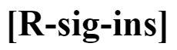









The R Environment is a collection of tools

Slide 4
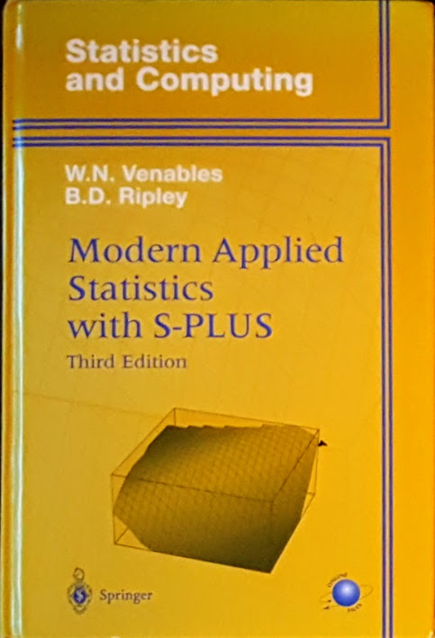
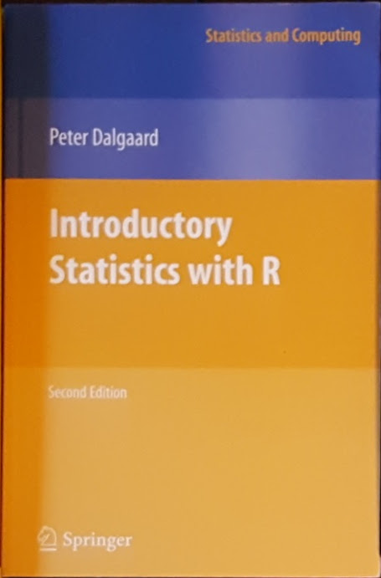






R is a great way to learn statistics

Slide 5
Recursive PARTitioning
Because CART is the trademarked name of a particular software implementation of these ideas, and tree has been used for the SPlus routines of Clark and Pregibon [2] a different acronym — Recursive PARTitioning or rpart — was chosen. It is somewhat humorous that this label “rpart” has now become more common than the original and more descriptive “cart”, a testament to the influence of freely available software.

Slide 6
rpart in action/detail
Start RStudio
Load the rpart library
Get help on the rpart function > ?rpart
Notes:
(Matt Dowle story – can you make a u turn here)

Slide 7

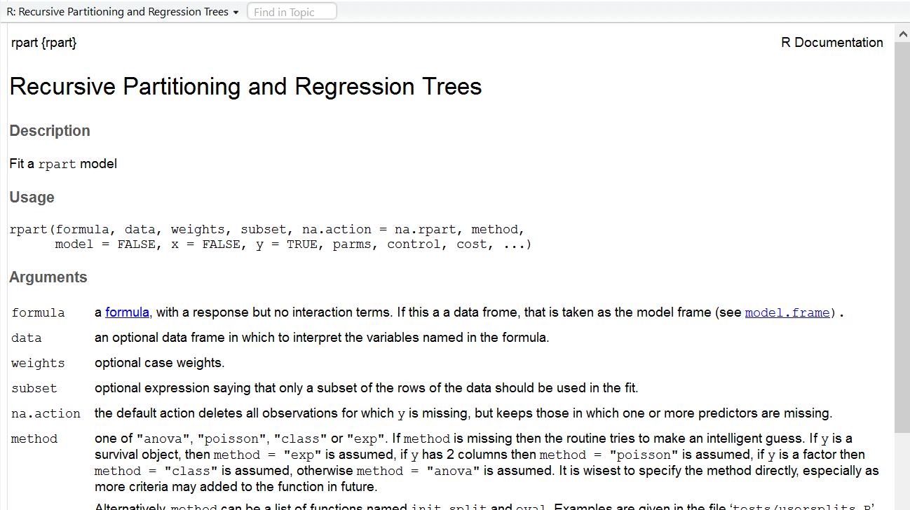
rpart help

Slide 8
Splitting the data with a shiny app

Slide 9
Building the formula with a shiny app

Slide 10
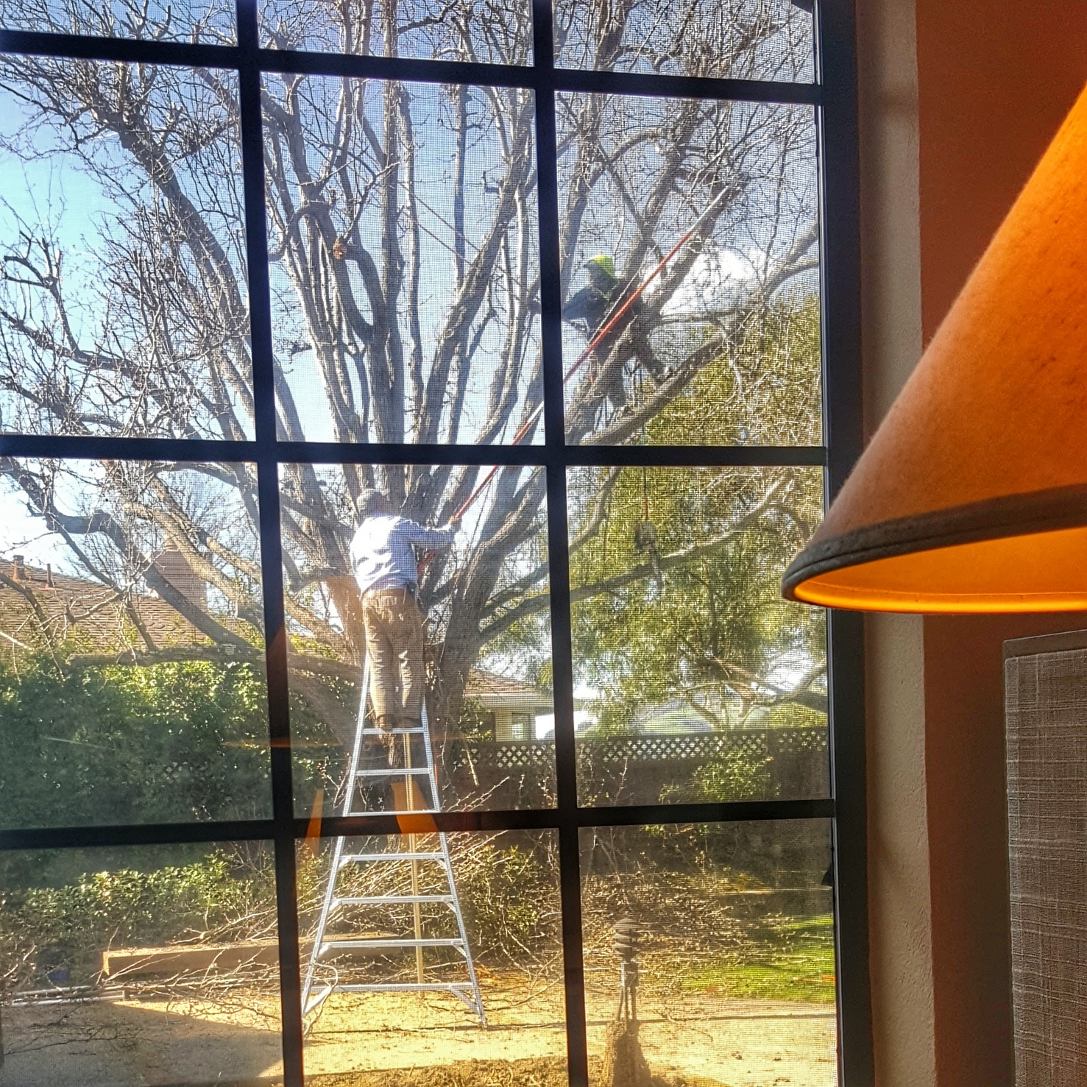
Thank you for having me!
Dan Murphy
Trinostics LLC San Francisco
https://cran.r-project.org/
https://www.rstudio.com/

